Slide 1

Object Detection using CNN
Deep learning project

Slide 2
Understanding what a convolutional neural network is ?
In deep learning, a convolutional neural network (CNN) is a class of deep neural network, most commonly applied to analyse visual imagery. Now when we think of a neural network we think about matrix multiplications but that is not the case with CNN. It uses a special technique called Convolution. Convolution is a mathematical operation on two functions that produces a third function that expresses how the shape of one is modified by the other. But we don’t really need to go behind the mathematics part to understand what a CNN is or how it works.

Slide 3

Architecture of convolutional neural network

Slide 4
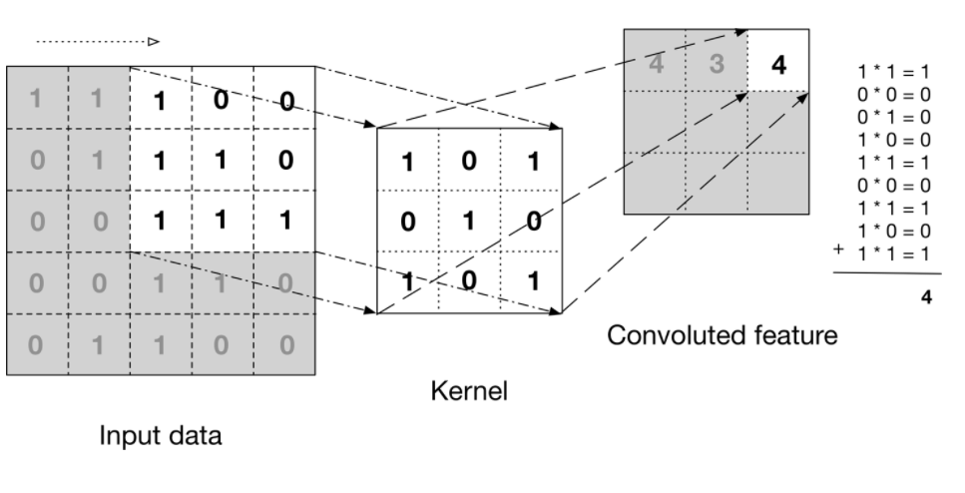
How it works ?
1st Layer. Convolution
The image shows what a convolution is. We take a filter/kernel(3×3 matrix) and apply it to the input image to get the convolved feature. This convolved feature is passed on to the next layer.

Slide 5
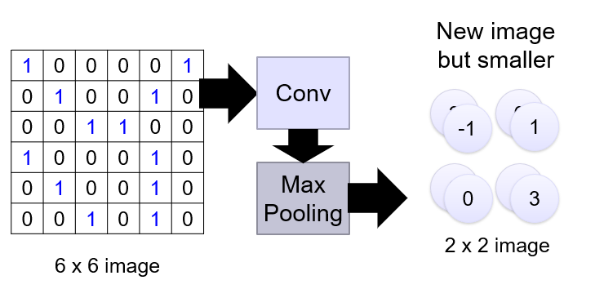
Understanding Pooling
2nd Layer.
Pooling
Similar to the Convolutional Layer, the Pooling layer is responsible for reducing the spatial size of the Convolved Feature. This is to decrease the computational power required to process the data by reducing the dimensions. There are two types of pooling average pooling and max pooling.

Slide 6
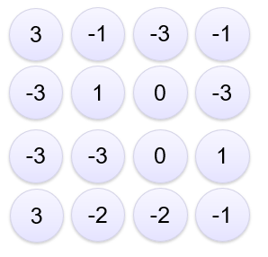
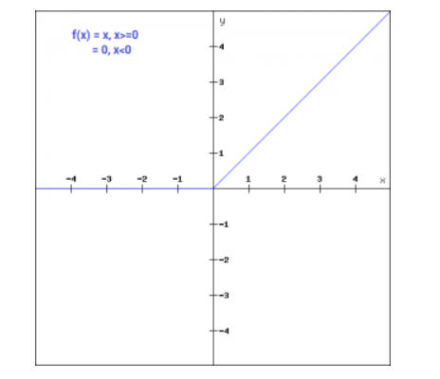
Activation Function
The ReLU function is non-linear activation function that has gained popularity in the deep learning. ReLU stands for Rectified Linear Unit. The main advantage of using the ReLU function over other activation functions is that it does not activate all the neurons at the same time. For the negative input values, the result is zero, that means the neuron does not get activated. Since only a certain number of neurons are activated, the ReLU function is far more computationally efficient
The convolutional feature matrix is plotted on a 2d graph. And using ReLU activation function, neg values are converted to zero and positive value neurons are activated.

Slide 7
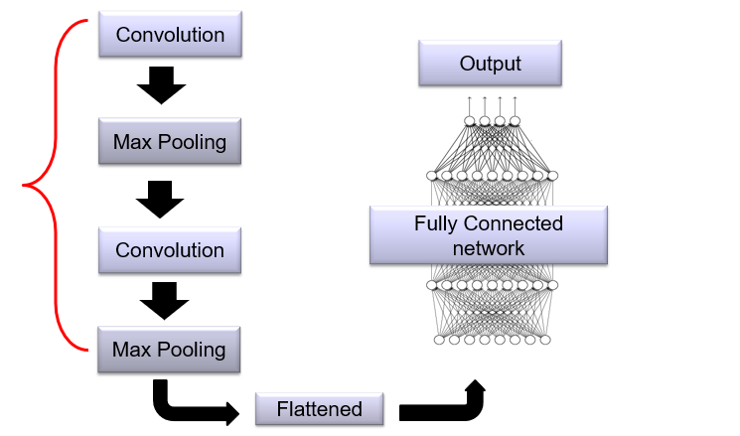
Adding new layers
There are no restrictions on adding more layers to the model. Adding new layers to the model actually improves the accuracy of the model. but there is a disadvantage, by adding more/new layers to the model, the time taken to train the model increases.

Slide 8
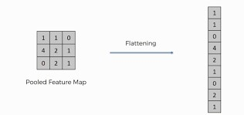
Understanding flattening
Flattening is converting the data into a 1-dimensional array for inputting it to the next layer. We flatten the output of the convolutional layers to create a single long feature vector. And it is connected to the final classification model, which is called a fully-connected layer.

Slide 9
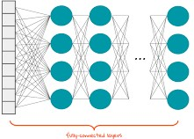
Dense / fully connected network
The dense layer is a fully connected layer, meaning all the neurons in a layer are connected to those in the next lay. A densely connected layer provides learning features from all the combinations of the features of the previous layer, whereas a convolutional layer relies on consistent features with a small repetitive field.

Slide 10
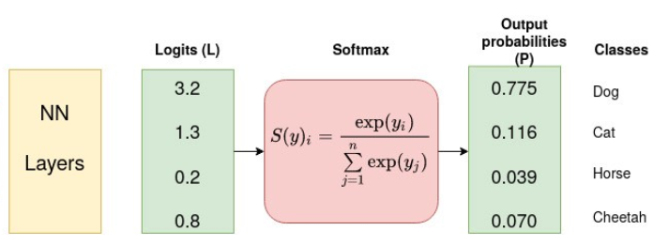
SoftMax activation function
Softmax is an activation function that scales numbers/Logits into probabilities. The output of a softmax is a vector (Say v) with probabilities of each possible outcome. The probabilities in vector v sums to one for all possible outcomes or classes.

Slide 11
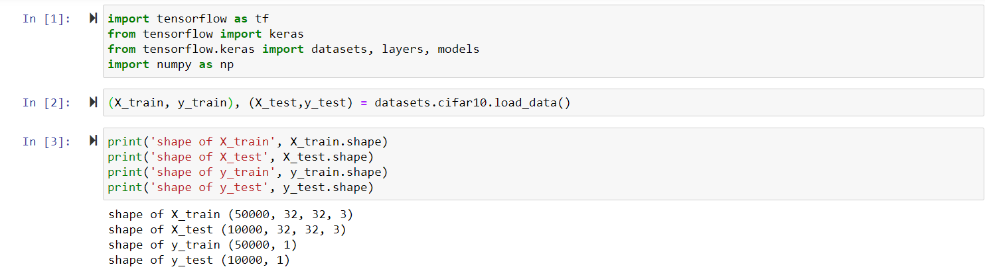
Now it’s time to look and understand the code
We have imported TensorFlow and keras libraries and split the dataset into training and testing. We can observe that there are 50,000 images in X_train and y_train. And 10,000 images in X_test and y_test. we also observe that there are 4 dimensions in X_train and X_test. These 4 dimensions are as follow.{Batch_size, height, weigh, and depth. where the first dimension represents the batch size of the image and the other three dimensions represent dimensions of the image which are height, width, and depth.}

Slide 12
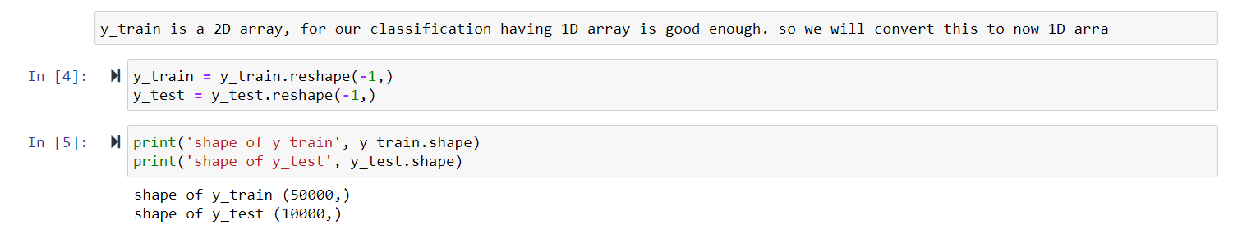
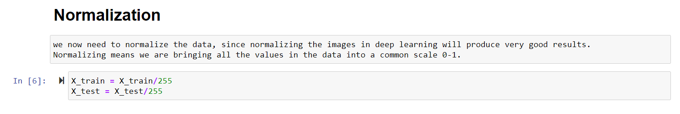
Dealing with data, to fit the model

Slide 13
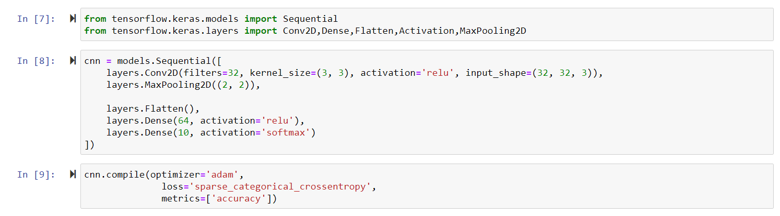
Building a single layer CNN
Training a single layer CNN model for10 epochs has produced prediction accuracy of 64%

Slide 14
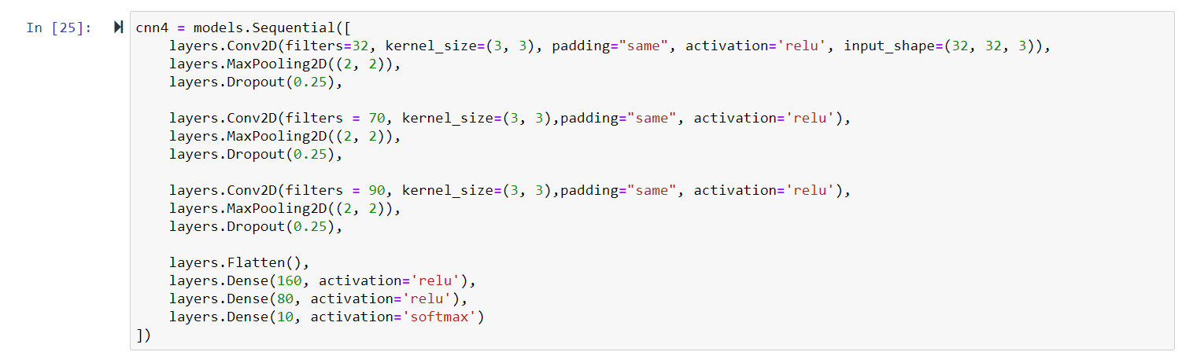
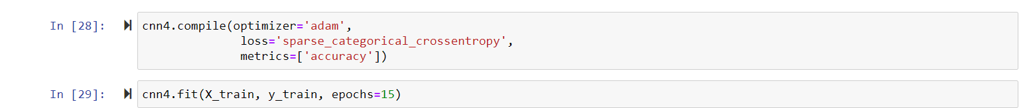
Building a multi layer CNN

Slide 15
Understanding the Model
I have added 3 layers of CNN.
Each layer consisting convolutional layer, pooling layer and dropout layer. After that comes flattening, the feature map is now converted to 1d array and is sent to dense neural network with relu in first 2 dense network and softmax for last dense network. And now the model is build.
Next, we need to compile our model. Compiling the model takes three parameters: optimizer, loss and metrics. The optimizer controls the learning rate. We will be using ‘adam’. We will use ‘sparse_categorical_crossentropy’ for our loss function. A lower score indicates that the model is performing better. Then we will use the ‘accuracy’ metric to see the accuracy score on the validation set when we train the model.
What is Dropout layer?
Dropout layer is used to drop the neural units from our network which weren’t activated.
This hep the next layer to learn the patterns easily.

Slide 16
Training the model
We have achieved only 75& % accuracy from the model, but that’s okay considering the times(15) the model is trained.
We can achieve higher accuracy but adding more layers to the model and increasing the training process.

Slide 17
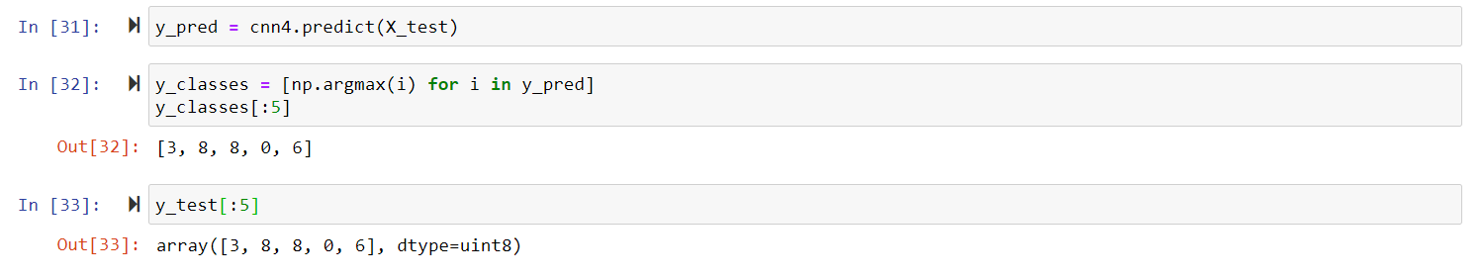
Predicting & validating the model performance
We can see that the model has predicted the first 5 images perfectly. Even though the model has only 74% accuracy rate.
What is np.argmax?
Basically argmax returns you the index of the maximum value in the array. Now the array can be 1 dimensional or multiple dimensions.

Slide 18
Thank you
Deep Learning project by -
Megnath
GitHub link:
https://github.com/Meg-Megnath

